Slide 1

CRY America
www.cryamerica.org

Slide 2



About Us
Our name is CRY, Child Rights and You America Inc [DBA: CRY America]
A 501c3 non-profit organization registered in USA
All donations to CRY America are tax exempt
Work for underprivileged children, especially Indian
We believe every child deserves a happy, healthy & creative childhood
Our values
- Trust
- Transparency
- Equality
- Accountability
- Collective action
We believe that each of us, as individuals, can make a difference

Slide 3

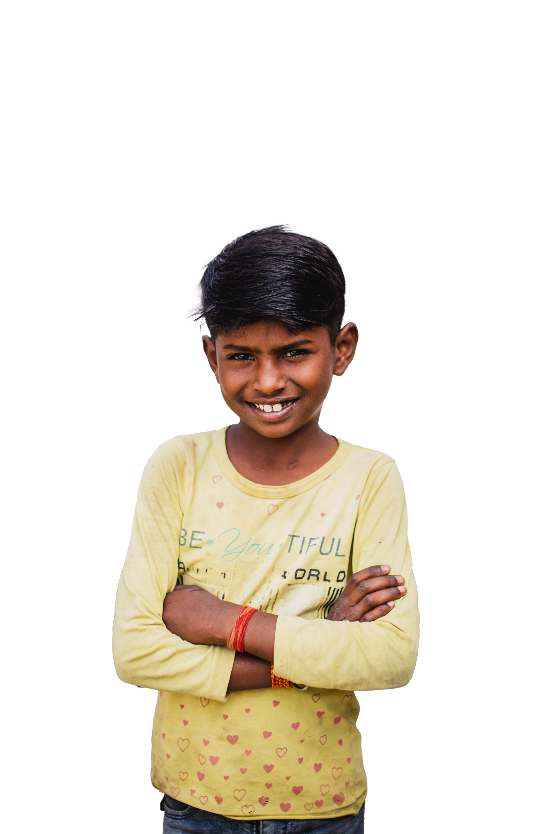
CRY America Overview
CRY America is driven by its vision of a just world in which all children have equal opportunities - regardless of gender, class, caste, faith, color, race, ethnicity, physical & mental ability - to develop to their full potential & realize their dreams
Supported Projects work with children, their parents & communities in rural, tribal & urban areas on the issues of education, healthcare, protection from child labor, child marriage and gender discrimination
CRY America’s strength lies in its donors, volunteers & project partners who have come together to change the situation of underprivileged children.

Slide 4

Our Vision
A happy, healthy & creative child whose rights are protected & honored in a society that is built on respect for dignity & justice for all.
Our Mission
To enable people to take responsibility for the situation of the deprived child, especially Indian, and so motivate them to confront the situation through collective action thereby giving the child and themselves an opportunity to realise their full potential

Slide 5
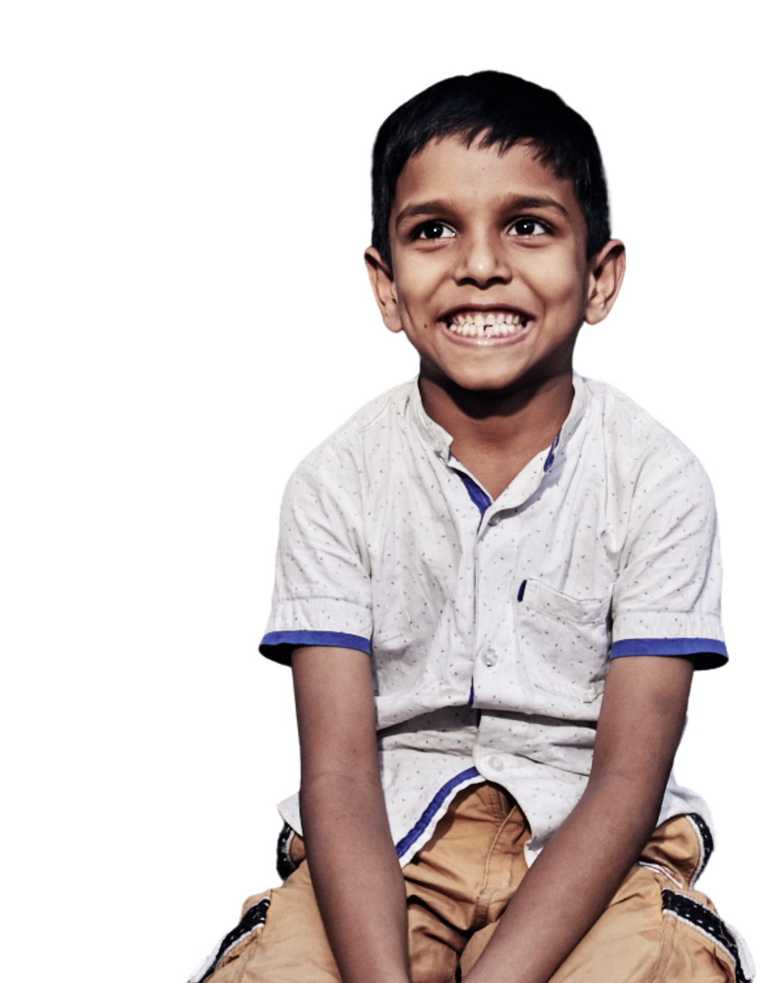
Child Rights
In 1989, the UN defined its Charter of Child Rights which specifies that every child has the right to
Survival – life, health, nutrition, name & nationality
Development – education, recreation, leisure
Protection - from child labor, child marriage, child abuse & gender discrimination
Participation – expression, information, thought and religion
India is a signatory to this convention, as are 191 other countries

Slide 6

Issues Supported by CRY America
We focus on the rights of underprivileged children across segments
Street children
Girl children
Child laborers
Children of commercial sex workers
Child abuse
Physically & mentally challenged children
Children in institutions
Children affected by disasters

Slide 7
What Does CRY America Do?
CHILD RIGHTS & YOU
CRY America
Donors
Volunteers
Foundations
Corporates
Media
Public
Government
Children in need
Project Partners

Slide 8
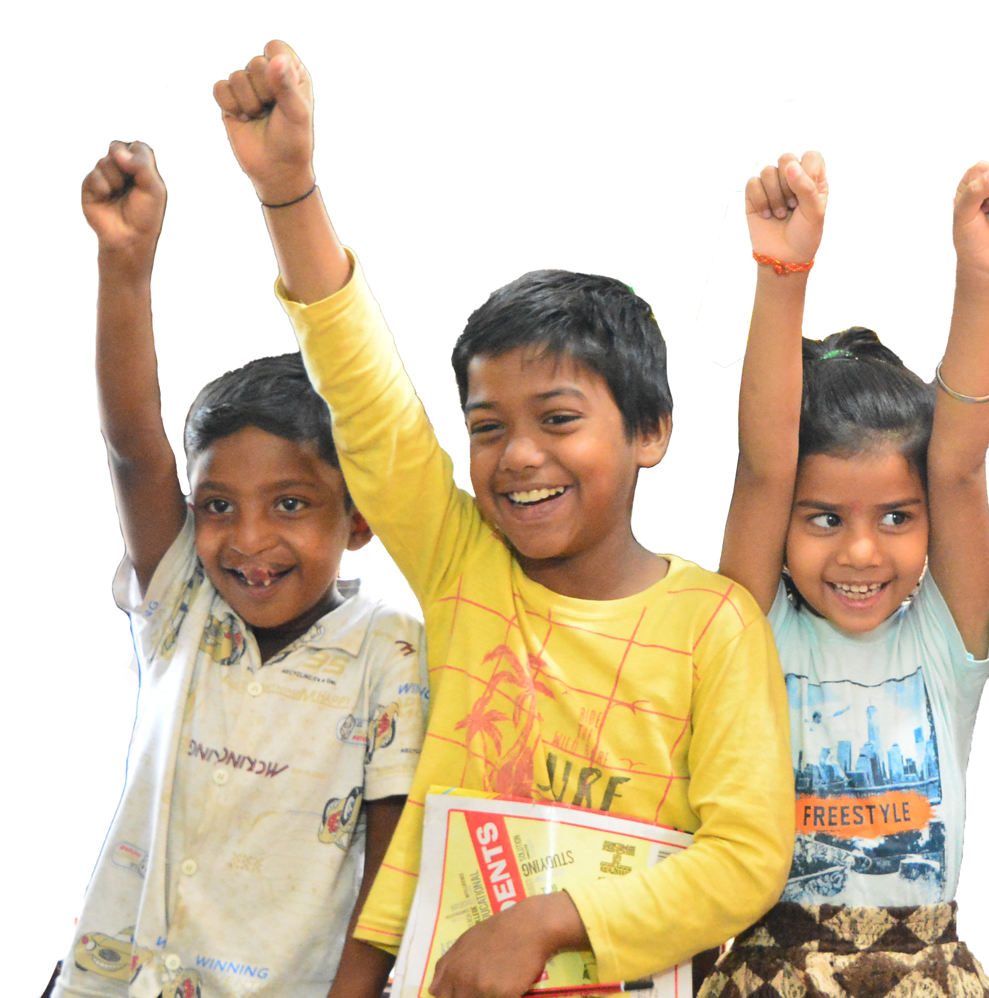
CRY America Grant Management
Angel investor/venture capitalist
Identify & support promising grass root projects
Projects are selected on the basis of
Their track record
Issues they work with
Impact on the community they work with
Effective utilization of local resources
We provide them with
Financial support
Program development
Capacity building & trainings
Perspective building on child rights
We work with our partner, CRY India, to ensure the quality grant management services for projects supported in India

Slide 9
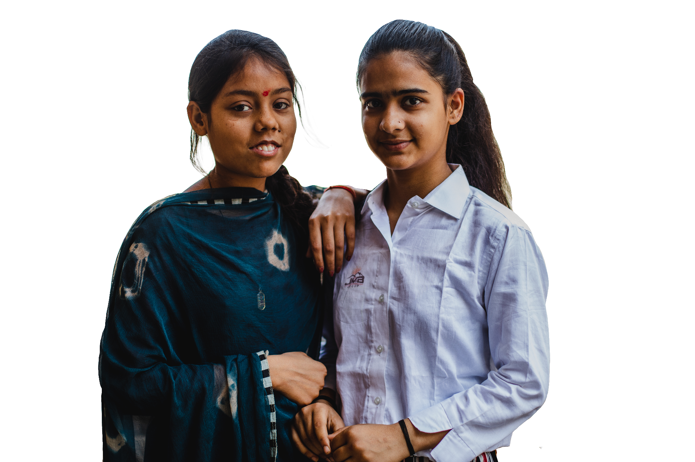
Our Impact
Very simply, we act as the link between
people like YOU who want to help underprivileged children and
the child in need, wherever she/he might be, in India or the USA
Creating sustainable instruments of social change for child rights
With the support of 25,000 generous donors & 2,000 committed volunteers in the USA, CRY America has impacted:
the lives of 800,000 underprivileged children
living across 5,000 villages and slums through
support to 111 Projects in India & the USA
Project impact & achievements regularly disseminated to donors, volunteers & public through newsletters, annual report, website

Slide 10




Turning Dreams into Reality with You
2024
Impact
2028 Projections
Children Impacted [Direct]
825,539
1,007,340
Children Impacted
[Indirect/ Multiplier Effect]
1,095,500
643,412
Villages & Slums
5,064
6,328
States & Districts
17 States &
50 Districts
17 States

Slide 11


Turning Dreams into Reality with You
2024 Impact
2028
Projections
Children in public schools & learning
[6 to 18 years] in operational areas
93%
[342,558]
97%
[643,095]
Children prevented from becoming child labor [6 to 18 years] in operational areas
79%
[346,432]
98%
[513,595]
Children prevented from malnutrition in operational areas
83%
[132,398]
100%
[217,586]
Children immunized [0 to 1 years] in operational areas
100%
[239,963]
100%
[284,590]

Slide 12
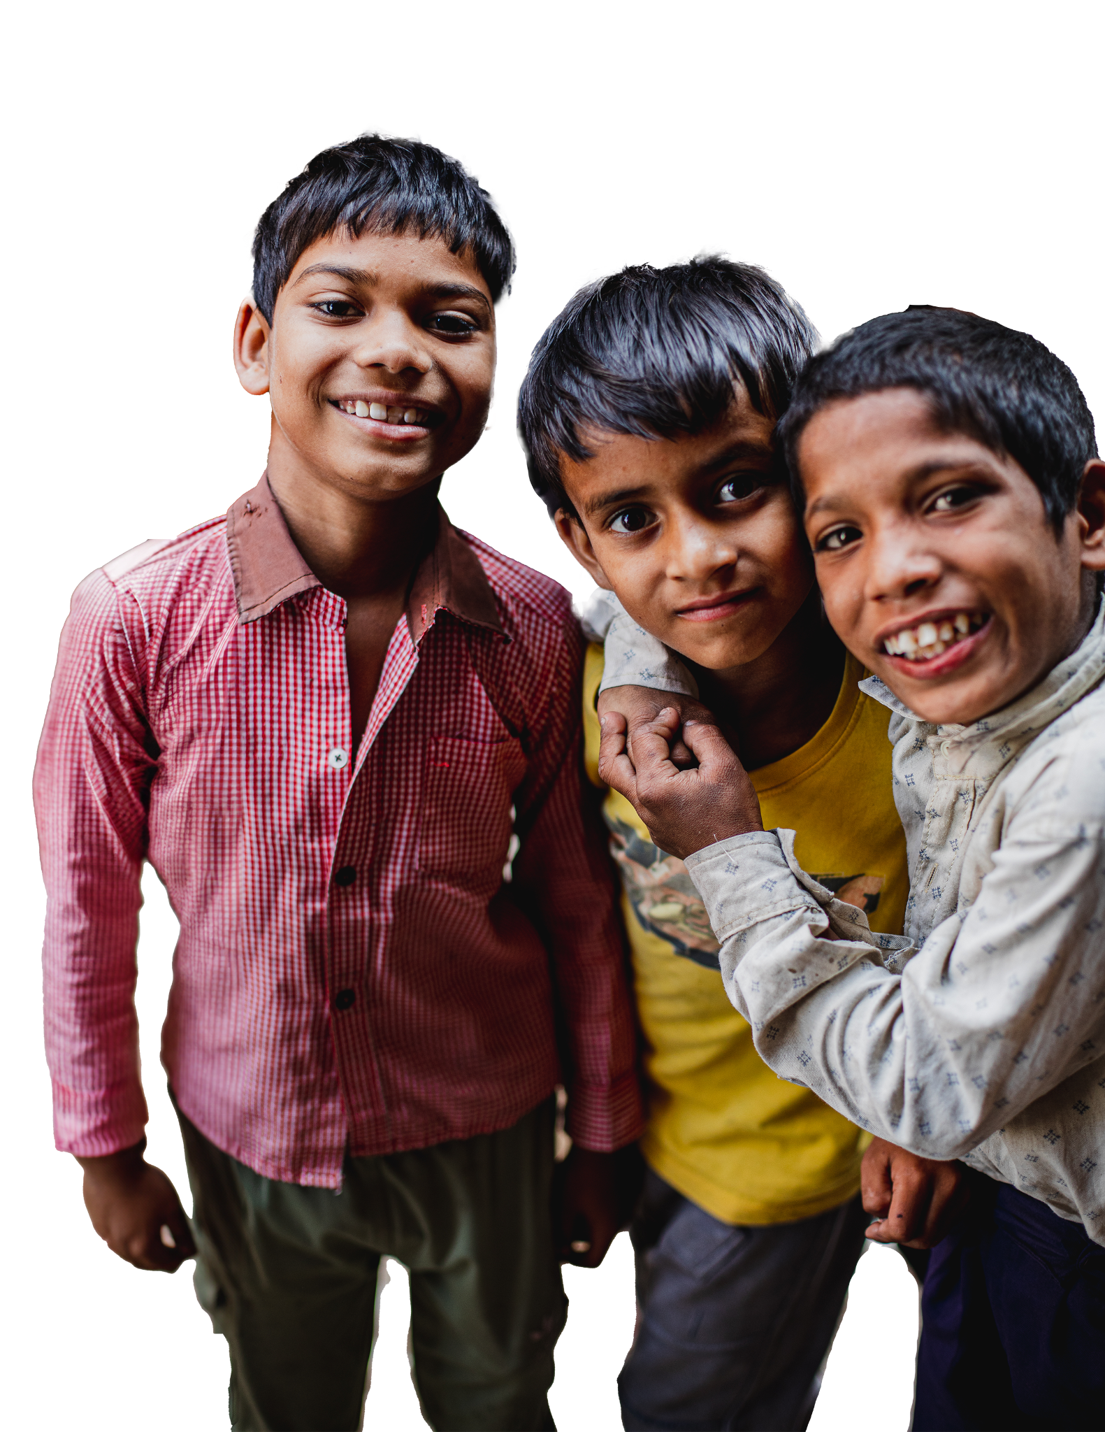
Accountability & Transparency
At Project level
Ongoing review of accounting books & systems
Half Yearly project visits, program & financial reports, grant remittances based on reviews
Capacity building to ensure effective programs
At CRY America level
Rigorous accounting systems & annual audit
KLR Outsourcing – internal accountants
Organization performance disseminated to public through newsletters, annual report, website
Organization-wide objective setting & performance reviews annually and half yearly
Projects supported by CRY America: https://www.cryamerica.org/grants/

Slide 13
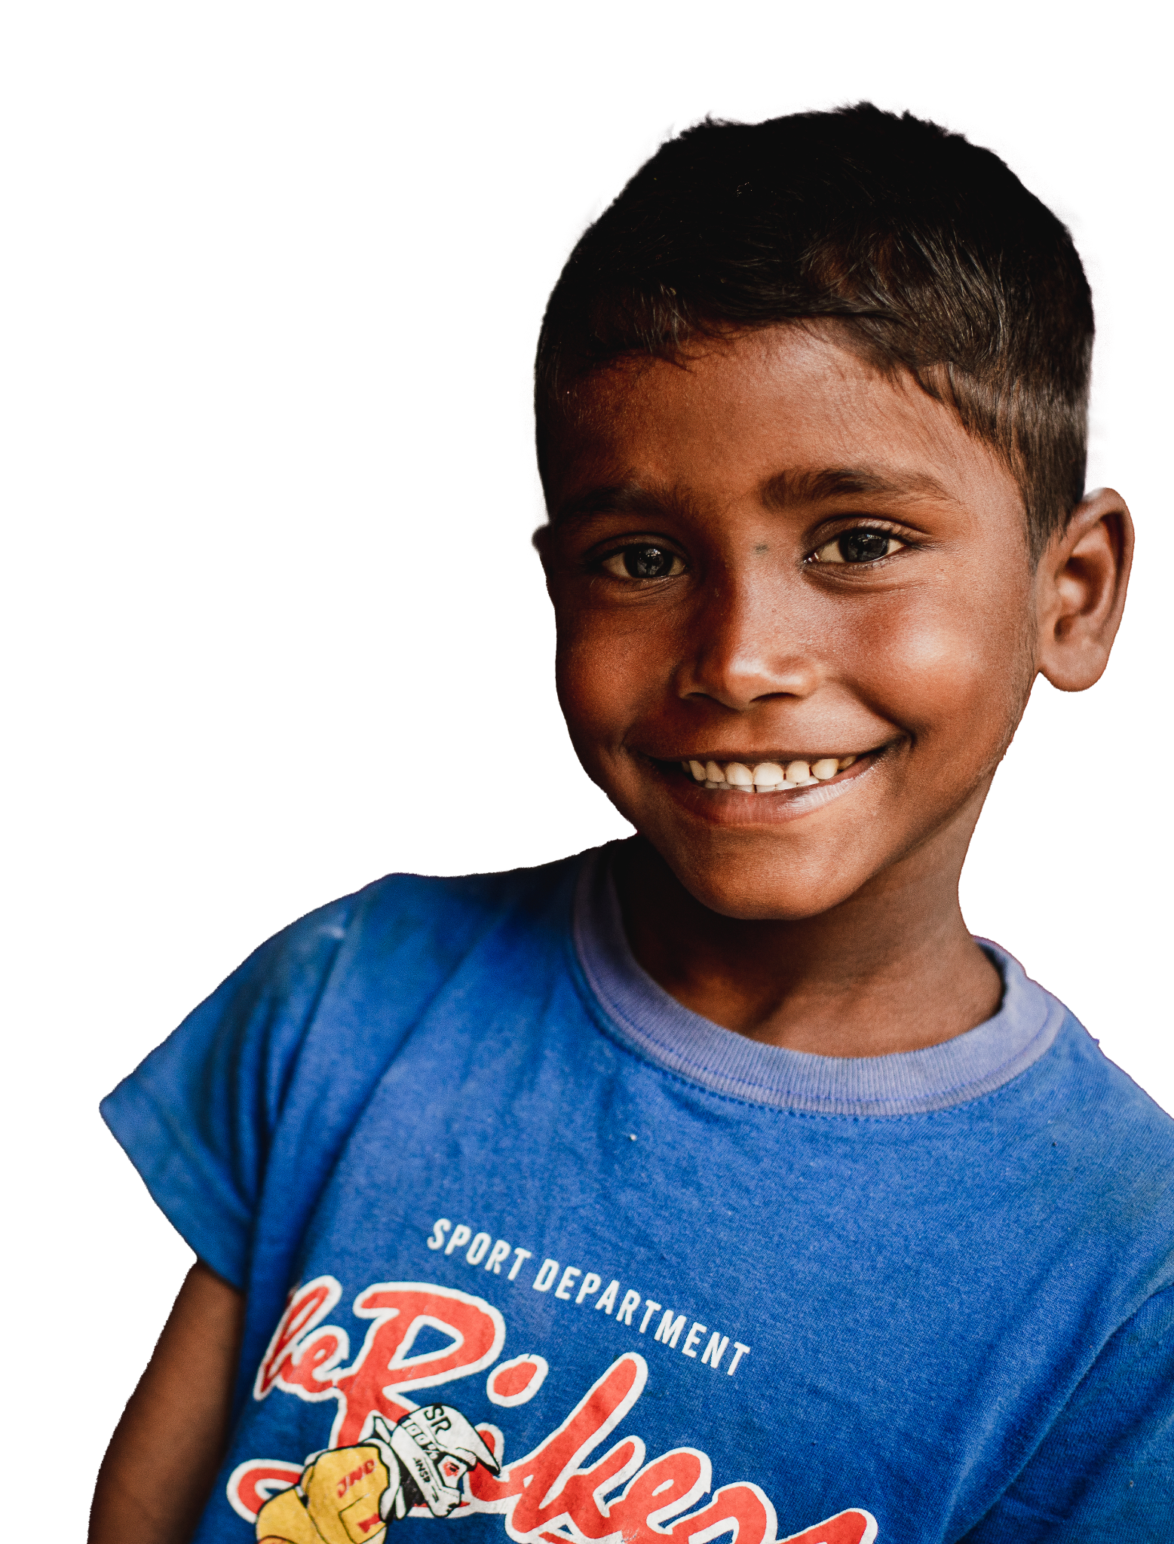
Who Can Help?
Anyone who has the potential to touch the lives of underprivileged children which really means … EVERYONE!
Individuals
Family Foundations
Foundations
Corporates
Small Businesses
Community Groups & Associations
Media Houses

Slide 14
Volunteer Engagement
Volunteers form the core of CRY America. Together, they form Chapters called Action Centers (AC’s)
Our volunteers come from different walks of life - they are professionals, entrepreneurs, students, homemakers & retirees.
Volunteers work among their friends, family, colleagues and within their local community to create an awareness about the situation of underprivileged children and help harness resources (financial and non-financial) for the cause.
Each Action Center is led and managed by an Action Center Leader and a committed group of Core Volunteers
AC’s conduct events in their local community such as CRY Holi, CRY Walk, CRY Dandia, CRYket, CRY Volleyball & other sports & cultural events

Slide 15
Volunteer Chapters at a Glance
Austin - austin@cryamerica.org
Bay Area - bayarea@cryamerica.org
Boston - boston@cryamerica.org
University of Washington Student Chapter - cryuwchapter@gmail.com
Delaware - delaware@cryamerica.org
Houston - houston@cryamerica.org
Kentucky - kentucky.cry@gmail.com
Los Angeles - losangeles@cryamerica.org
New Jersey - newjersey@cryamerica.org
Orange County - orangecountyca@cryamerica.org
Phoenix - phoenix@cryamerica.org
San Antonio - sanantonio@cryamerica.org
San Diego - sandiego@cryamerica.org
San Ramon Student Chapter - cryamericasr@cryamerica.org
Seattle - seattle@cryamerica.org
Tennessee - tennessee@cryamerica.org

Slide 16
Events organized by Volunteer Chapters
National Events by Action Centers:
CRY Walk
CRY Cricket / CRYket Tournament
CRY Holi
CRY Dandia / Garba Evening
CRY Volleyball / Throwball Tournament
Local Events by Action Centers:
Kite Flying Festival
Bowling Evening
Mixer / Karaoke Evening
Local Music / Dance Events
Movie Screenings
Food Festival / Stalls
CRY America Booths & Stalls
Volunteer Retention & Engagement Efforts
Planning, promotion, execution of local community events
Whatsapp groups & F2F meetings
Volunteer appreciation & awards
Volunteer Acquisition Efforts
Volunteer get volunteer
Volunteer led events
Website & Social media

Slide 17

CRY Gala’s
Our CRY Gala is an evening dedicated to bringing high net worth individuals together for the cause of children
Black-tie fundraising banquet that attracts donors & sponsors from the location
6 Cities: Bay Area, San Diego, Seattle, Austin, Houston, New York
Gala Committees play a key role in successful events
Celebrity Guests elevate interest & fundraising & have included Vivek Oberoi, Arjun Rampal, Sharmila Tagore, Shabana Azmi, Konkona Sen, Usha Uthup, Nirupama Rao, Fareed Zakaria
Corporate Speakers are invited to address the guests

Slide 18
Ways to Give
Monthly Giving
Gives children the steady support they need &
Helps us plan our work in a sustainable manner
My Occasion & CRY
Celebrating your birthday, graduation or wedding?
Set up your online fundraising page & share your special occasion with children
Direct Project Funding
Support a project of your choice with $2500+
Stock Donations
Make a stock donation & get a tax deduction
Legacy Giving
Benefit children for years to come by adding CRY America as a beneficiary to your will or trust

Slide 19
Corporates & Foundations
Event Sponsorships
Support CRY America Events such as the CRY Galas, CRY Walk, CRYket, CRY Dandia etc
Promote your business & benefit children
Project Grants
Fund a CRY Project that restores rights to underprivileged children in India or USA by donating $2500 or more
Matching Gifts
Your Company can match every dollar you give to CRY America, allowing every donation you make to be twice as powerful for children
Employee / Payroll Giving
Consider monthly payroll giving which your Company will also match
Monthly provides sustainable support to children

Slide 20
Media & Social Media
Media Outreach
National & local media coverage for key events & project impact stories across
TV, Radio, Print publications, online portals
CRY America Facebook & Instagram
Impact stories, event promotions, volunteer appreciation, special day posts
CRY America LinkedIn
Thought leadership of critical issues of children, CRY’s work & project impact stories
Identifying business & community leaders
Influencers, Business Leaders, Community Leaders
Develop connections & build relations to increase outreach & brand building

Slide 21
CRY America in the News
Indica News – Bay Area gala spotlight
https://humhindustaniusa.com/epaper/edition/418/09052025/page/19
Hum Hindustani – San Diego Gala spotlight
https://humhindustaniusa.com/epaper/edition/418/09052025/page/19
Indo American News – Houston Gala spotlight
https://www.indoamerican-news.com/shabana-azmi-appeals-to-the-indian-diaspora-to-support-cry-childrens-issues/
Shabana Azmi talks to Kanika Chadda, NY Influencer
https://www.youtube.com/watch?v=HAKoKlw0_YE
Shabana Azmi & Project PORD Director with ITV Gold at the CRY NY Gala
https://www.youtube.com/watch?v=MBi1rZZvFsQ
Shabana Azmi talks to TV Asia at the CRY Gala
https://www.youtube.com/watch?v=zP_wF-km_2k

Slide 22
CRY America Contacts, Website & Social Handles
CRY America Contacts
General Queries: support@cryamerica.org
Volunteer Engagement: volunteers@cryamerica.org
Donation & Event Sponsorships: patrick.bocco@cryamerica.org
Accounts & Matching: accounts@cryamerica.org
CRY America Websites
CRY America Website: cryamerica.org
CRY Gala’s: https://cryamerica.org/site/events/upcoming-dinners.html
CRY Volunteer Events: https://events.cryamerica.org/event-category/crywalk/
CRY America Social Media Handles:
CRY America LinkedIn: https://www.linkedin.com/company/1075339/admin/
Facebook: https://www.facebook.com/america.cry
Instagram: https://www.instagram.com/cry.america/

